Slide 1
CAN and pSEARCH
Paulo Shakarian

Slide 2
Papers
A Scalable Content-Addressable Network
  “CAN”
  Multi-dimensional distributed hash table with heuristics to reduce latency
  ACM SIGCOM (2001)
  Ratnasamy/Francis/Handley/Karp/Shenker
pSEARCH: Information Retrieval in Structured Overlays
  “pVSM” and “pLSI”
  Uses information retrieval techniques on top of a DHT to provide search capabilities
  ACM SIGCOM (2003)
  Tang/Xu/Mahalingham

Slide 3
Part 1:
CAN

Slide 4
CAN - Outline
The Basics
Routing
Adding a New Node
Departing Nodes
Improvements
Simulation Results

Slide 5
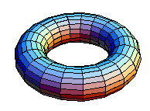
The Basics
d-dimensional torus
Torus is partitioned among all nodes in system – each node owns a “zone” in the torus. Every node has a pointer to its neighbor nodes (i.e. all zones that overlap in d-1 dimensions and are adjacent in 1 dimension)
Key/value pair (k,v) is mapped to point p in the torus with a hash function (i.e. hash(k)=p)
The node that owns the zone of point p then stores the (k,v)
Want to look up value for key k? Simply determine the point using the same hash function.
If p is not in the zone owned by the node, or one of its neighbors – greedy search

Slide 6

Routing
CAN nodes only maintain pointers to their neighbors.
At each step, CAN routes message to neighbor node whose coordinate distance is the closest, this simple greedy algorithm bounds the number of hops by
Because of how new nodes join the system, a CAN node can have 2d neighbors

Slide 7
Routing
Node 5 wants access value associated with the key K.
Hash of key K gives point (x’,y’)
Node 5 greedily routes its message to node 4, which owns the zone that contains point (x’,y’)
(x’,y’)
4
5

Slide 8
Routing
Can obtain the same result as Chord:
  Chord has O(log n) entries per node and O(log n) hops
  Set d=log(n)/2
However, CAN authors wanted d to be independent of the number of nodes

Slide 9
Adding a New Node
To add node X, we need the following:
  Known node in the CAN network
  Point p in the torus
X simply has the known node route him to the owner of the zone of point p
The owner of point p’s zone then splits into two
X is assigned one of the new zones
Affects only O(d) number of nodes

Slide 10
Adding a New Node
New node 6, known node 5
Point (x’,y’) picked at random
CAN routes to node 4’s zone (current owner of (x’,y’)
(x’,y’)
4
5

Slide 11
Adding a New Node
Node 4’s zone is split in half
Node 6 gets half of node 4’s zone (and the keys, value pairs associated with points in that zone)
Neighbors of node 6 and 4 are updated
Old neighbors of node 4 notified of the update
6
(x’,y’)
4
5

Slide 12
Departing Nodes
Expected – hand zone over to a neighbor
Unexpected (node X dies) – neighbor of X sends out TAKEOVER message to other neighbors of X notifying them he is taking over X’s zone.
  Upon receipt of TAKEOVER message, other nodes stop countdown timer to takeover of X’s zone
Large failures – routing resorts to expanding ring

Slide 13
Improvements
Reduce number of hops (often provable)
  Simply count number of hops
Heuristics to reduce latency (tested with simulation)

Slide 14
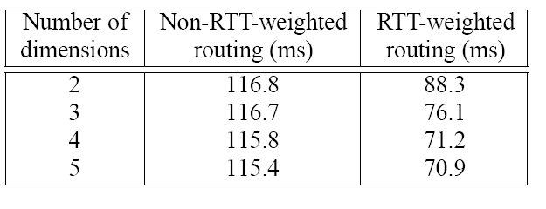
RTT Routing
Heuristic to improve latency
Node X weights neighbor distance to goal point using round-trip-time to each neighbor.

Slide 15
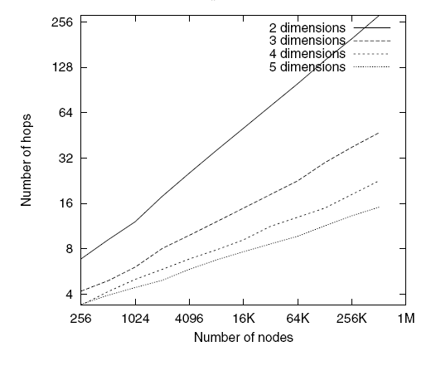

Dimensionality
Path length scales as

Slide 16
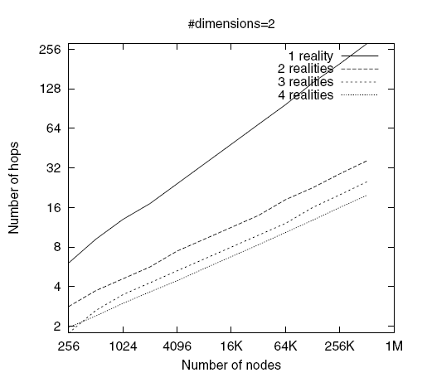
Realities
A reality is simply another coordinate space
With R realities, each node increases its storage requirement (and lookup-table) by a factor of R.
Example, the hash of key k is (x,y). With 4 realities, the key is stored on 4 different nodes.
Gives more options on routing.

Slide 17
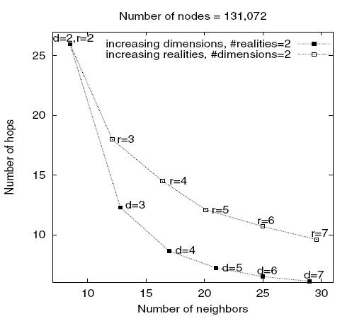
Realities vs. Dimensions
Dimension increase generally leads to fewer hops

Slide 18
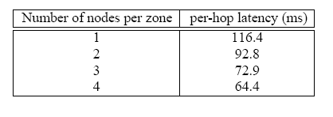
Overloading Zones
Each zone has MAXPEERS number of nodes associated with it.
Ensures redundancy and ability to greedily choose node with least RTT
  Periodically, a node sends a message to its neighbor for list of peers
  The node then pings peers
  Peer with least RTT becomes the new neighbor
If zone has MAXPEERS nodes and new node joins, it is split

Slide 19
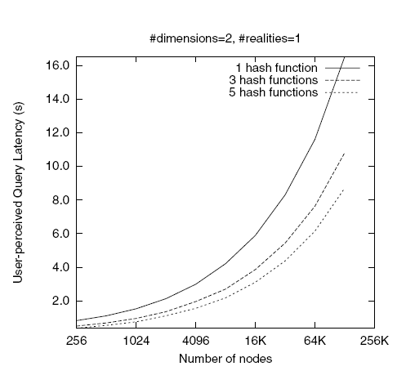
Multiple Hash Functions
Use k hash functions, so each key is now mapped to k different points.
Each node’s storage is increased by a factor of k
Reduces latency as we now have multiple neighbors to select from.
Provides redundancy as well.

Slide 20
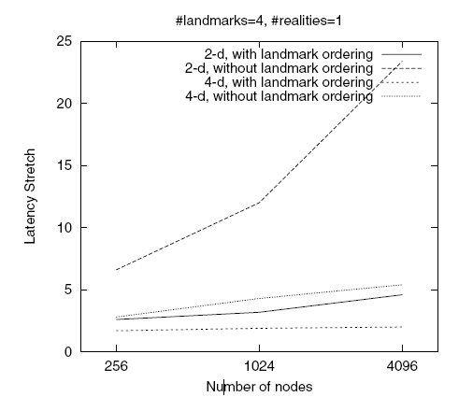
Landmarks
Normal CAN construction has nodes choose a random point in the torus.
A landmark is a known server (such as a DNS) – have m landmarks
Partition coordinate space into m! partions (based on how near the partition is to each landmark)
Now, nodes join based on selecting a random point in its landmark partition.
Shown to decrease latency stretch (ratio CAN network latency to average latency)
Not fully explored in this paper

Slide 21
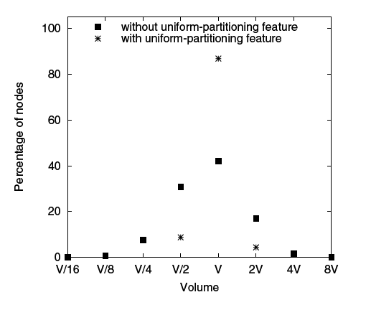
Volume Balancing
Instead of node X splitting its zone with a new node, X checks the volume of its neighbors, and the node with largest volume splits.
Results show that this technique balances the volume of the coordinate space better.

Slide 22
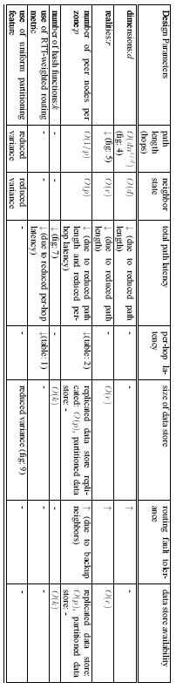
Effects of Improvements

Slide 23
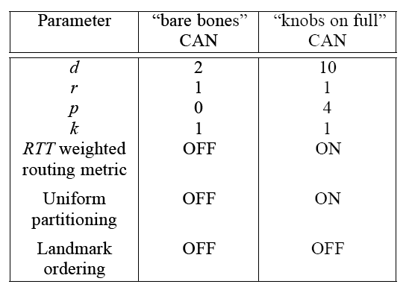
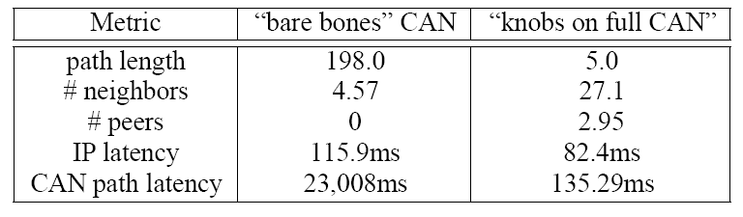
Simulation Results
d = dimensions
r = realities
p = number of peers
k = number of hash functions

Slide 24
Part 2:
pVSM/pLSI

Slide 25
Outline
Basic Idea
VSM/pVSM
LSI/pLSI
Experiments

Slide 26
Basic Idea
Authors want to do textual searching without a central index
To do this, they build two information-retrieval algorithms on top of eCAN
  Vector-Space Model
  Latent Semantic Indexing

Slide 27
VSM
Documents and queries are represented as “term vectors”
Each element of the vector represents an importance of a word
Weight of element is the product term frequency and inverse document frequency
Measure of similarity is normally cosine between two vectors

Slide 28
pVSM
Given a document, the m most relevant terms are identified (this is the term vector)
Each document is given an index value
For each term, t₁,…, t_{i},…t_{m}, are stored in eCAN as (hash(t_{i}), index) – that is term t_{i} is stored at node hash(t_{i}) which points to index that contains the document
Example follows…

Slide 29
pVSM
Doc A’s relevant key words are dog and Labrador
  pVSM id’s relevant key words
  Index is published to corresponding nodes
Doc A
Rottweiler
dog
Labrador

Slide 30
pVSM
Doc B’s relevant key words are dog and Rottweiler
Doc B
Doc A
Rottweiler
dog
Labrador

Slide 31
pVSM
Query “Rottweiler and dog”
  eCAN forwards user to nodes relevant to these two queries
Nodes w. matching indices returned using VSM (Doc B)
Doc B
Doc A
Rottweiler
dog
Labrador
Query

Slide 32
pVSM Issues
Needs Thesaurus to handle synonyms
Relies on global statistics on word count
  Uses combining tree (root is well-known node, probably based on a landmark)
  Randomly chooses nodes to sample statistics
  Expect size of statistics to grow slowly, hence statistics will change slowly

Slide 33
LSI
Uses singular value decomposition (SVD) to transform and truncate term matrices of VSM
For instance, car, automobile, and vehicle are different terms, but may have related semantics
Vectors transformed w. SVD and then measured as per VSM
Reduces noise of VSM, handles synonyms

Slide 34
pLSI (Naïve)
For a given document (or query), a term vector is produced and then, through SVD, a semantic vector is produced
For a given semantic vector, r is the radius in the semantic space of similar vectors
If we map the semantic space to CAN space, and produce a query, we simply flood the nodes within a radius of r from the final destination of the query.
Example follows…

Slide 35
pLSI (Naïve)
Suppose we have document C with relevant terms canine and Rottweiler
Doc B
Doc A
Rottweiler
Doc C
canine
dog
Labrador
hound

Slide 36
pLSI (Naïve)
The user queries “dog and Rottweiler”
Under normal pVSM, Document C may not be relevant
Doc B
Doc A
Rottweiler
Doc C
canine
dog
Labrador
hound
Query

Slide 37
pLSI (Naïve)
Suppose r=1
The eCAN query now floods the neighbors of dog
Now the nodes canine and hound are detected
Hence, Document C may be relevant as it contains “canine and Rottweiler”
Doc B
Doc A
Rottweiler
Doc C
canine
dog
Labrador
hound
Query

Slide 38
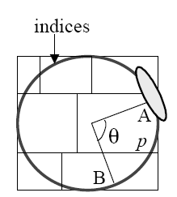
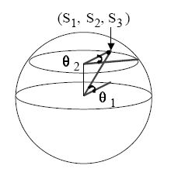

Issue 1 in Naïve pLSI:
Unbalanced Load Due to Semantic Space
Sphere distribution of semantic vectors: semantic vectors reside on the surface of a sphere, causing an unbalanced load
Solution: use a torus for eCAN of one dimension smaller than the semantic space and use a transformation from semantic vector to a “parameter vector”

Slide 39
Issue 2 in Naïve pLSI:
Uneven distribution of semantic vectors
A semantic space in LSI does not evenly distribute the vectors, even if issue 1 is solved
Solution: when a node joins the eCAN network, instead of picking a random coordinate in the eCAN torus, pick a (random) document that the node is going to publish and compute its parameter vector as the node to be routed toward.
Effects:
  Load Balancing: Ensures each node stores roughly the same number of indices
  Index Locality: The contents of the index is most likely near the node with the index
  Query Locality: Nodes with similar content will most likely be near this new node

Slide 40
Issue 3 in Naïve pLSI:
Dimensionality
Due to large dimensionality of semantic space (100’s of dimensions), a nearest neighbor approach will visit a majority of the nodes
Solution: parameter vector is divided into sub-vectors (by relevance) each sub-vector is searched on a different plane (like a “reality”) – hence an index for a given document must be stored on each plane

Slide 41
Issue 4 in Naïve pLSI:
Global Information
Same problem/solution as with pVSM

Slide 42
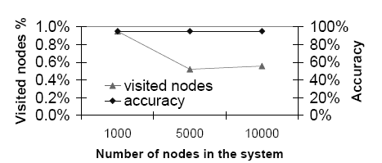
Experiments
pVSM tested w. MEDLINE corpus – results as good as VSM (returns a document with a high probability that at least one of top 30 terms in document was in query)
pLSI tested on TRERC corpus – obtains accuracy of 95% visiting 0.4-1.0% of nodes (results to the right)
pVSM publishes more copies of the index, but usually sends a query to less nodes

Slide 43
Questions?

